Slide 1
Adidas Sales Dashboard

Slide 2
Introduction
This dashboard provides a complete view of Adidas sales performance.
It combines sales, profit, products, regions, retailers, and states.
Helps management understand where revenue comes from and where to improve.
This dashboard is designed to give decision-makers a single view of Adidas business performance.

Slide 3
Business Objective
Identify high-revenue and low-revenue areas.
Track profitability, not just sales.
Understand customer demand using units sold.
Support decisions related to marketing, inventory, and expansion.
Business angle : Companies don’t just look at sales numbers; they look at where and how sales happen.

Slide 4
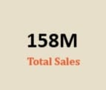

Sales KPIs
Total Sales :
Represents total revenue generated.
Indicates market demand and brand strength.
Operating Profit :
Shows earnings after operational costs.
High profit means efficient cost control.

Slide 5
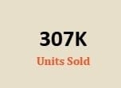
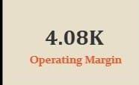
Units Sold :
Measures product demandHelps with inventory and supply planning
Operating Margin :
Profit as a percentage of salesHigher margin = healthy and sustainable business.
Strong profit along with high sales means Adidas is not just selling more, but selling efficiently.”

Slide 6
Sales Trend Analysis
Sales are not constant across time
Peaks may indicate:
Festive seasons
Discounts or promotions
New product launches
Declines may indicate:
Off-season periods
Reduced demand
Supply issues
Business value : Trend analysis helps predict future demand and avoid overstock or shortage.

Slide 7
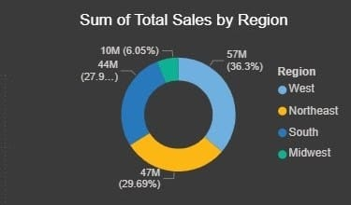
Regional Performance
West & Northeast are core revenue regions.
These regions may have :
Higher purchasing power
Better brand presence
Strong retail networks
Midwest & South show untapped potential
Recommendation insight :
Increase marketing in low-performing regions
Improve retail availability
Region-wise analysis helps allocate budgets more effectively.

Slide 8
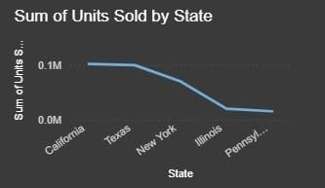
State-wise Sales
States like California & Texas show high sales due to:
Population density
Urban demand
Low-performing states indicate:
Limited awareness
Distribution gaps
Actionable insight:
Local promotions
State-specific campaigns
State-level analysis helps in targeted marketing instead of blanket strategies.

Slide 9
Recommendations
Expand in high-growth regions
Improve presence in low-performing states
Promote top-selling products more
Optimize underperforming product lines
Use trend data for future forecasting
Overall, this dashboard supports smarter and faster business decisions.

Slide 10
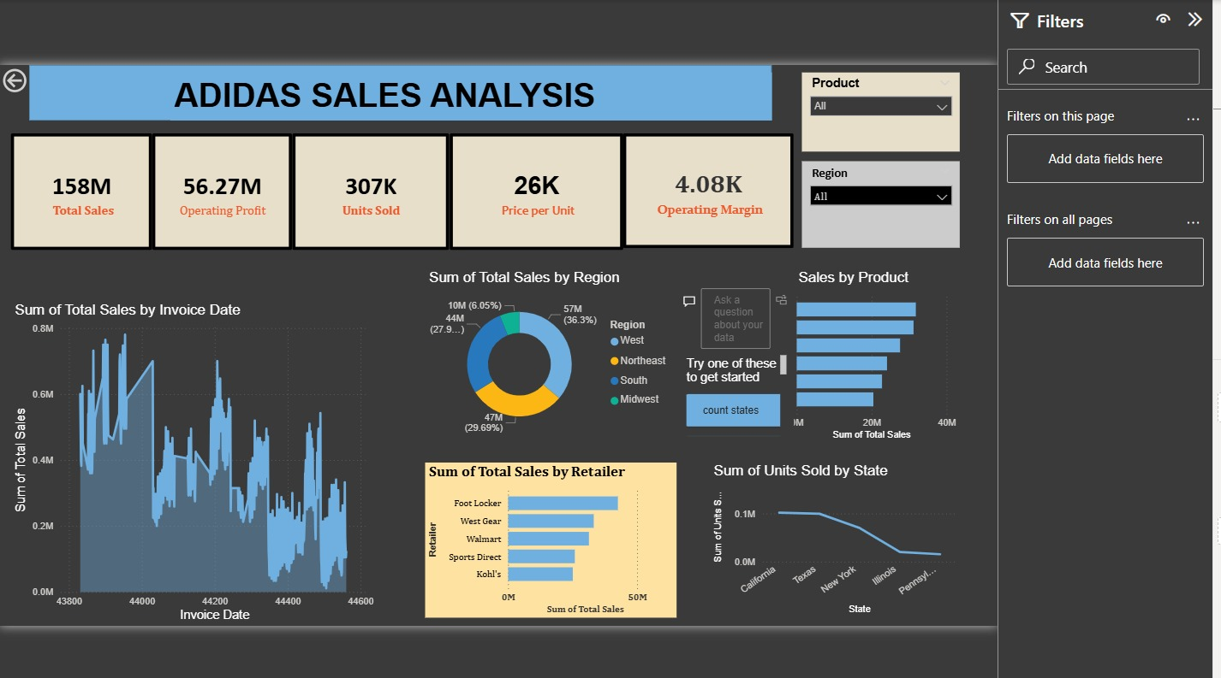
Conclusion
The dashboard helps Adidas understand where it is performing well and where improvements are needed, enabling smarter and more focused business decisions.

